Slide 1
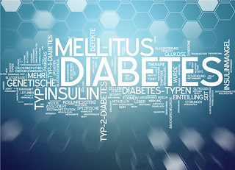
DIABETES PREDICTION SYSTEM
Presented By
SONU KUMAR

Slide 2
ABSTRACT :-
Diabetes is caused due to an increase in blood sugar levels and is one of the most chronic and life-threatening diseases.
If not treated or diagnosed early, it can lead to serious health complications like heart disease, kidney failure, and nerve damage.
The aim of this project is to develop a system that can predict the likelihood of diabetes using machine learning techniques.
The system uses patient data like glucose level, blood pressure, insulin, BMI, and age to predict a quick prediction.
Various ML algorithms like Decision Tree, Support Vector Machine, and Random Forest are used.
The performances of these algorithms are evaluated on various measures like Precision, Accuracy, F-Score, and Recall.
This project demonstrates how technology and AI can help in early diagnosis and improve public health awareness.

Slide 3
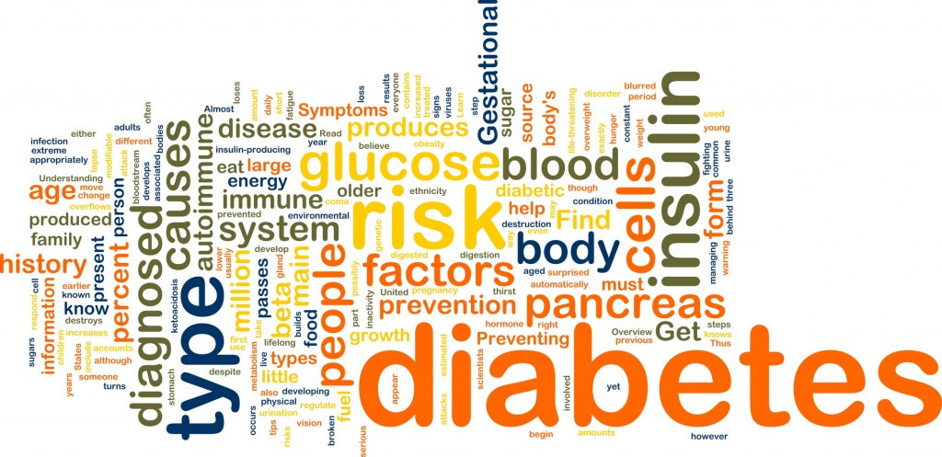
Problem Definition:-
Diabetes is a growing global health concern affecting millions of people.
Early detection is crucial to prevent serious health complications.
Many individuals remain unaware of their diabetic condition until it becomes severe.
Regular doctor visits for health check-ups are not always feasible due to cost, time, or lack of access.
There is a need for a simple, accessible, and quick tool to help people assess their risk of diabetes using basic health details.

Slide 4
Introduction
Diabetes is one of the most noxious diseases in the world.
Diabetes is caused because of obesity, high blood glucose level.
Approximately 537 million adults (20-79 years) are living with diabetes. The total number of people living with diabetes is projected to rise to 643 million by 2030 and 783 million by 2045.
The types of Diabetes are ; Type 1 ,Type 2 and Type 3
Type 1 diabetes means that the immune system is compromised, and the cells fail to produce insulin in sufficient amounts.
Type 2 diabetes means that the cells produce a low quantity of insulin, or the body can’t use the insulin correctly.
Type 3- Gestational diabetes is a type of diabetes that develops during pregnancy. Gestational diabetes is usually diagnosed in the 24th to 28th week of pregnancy.

Slide 5
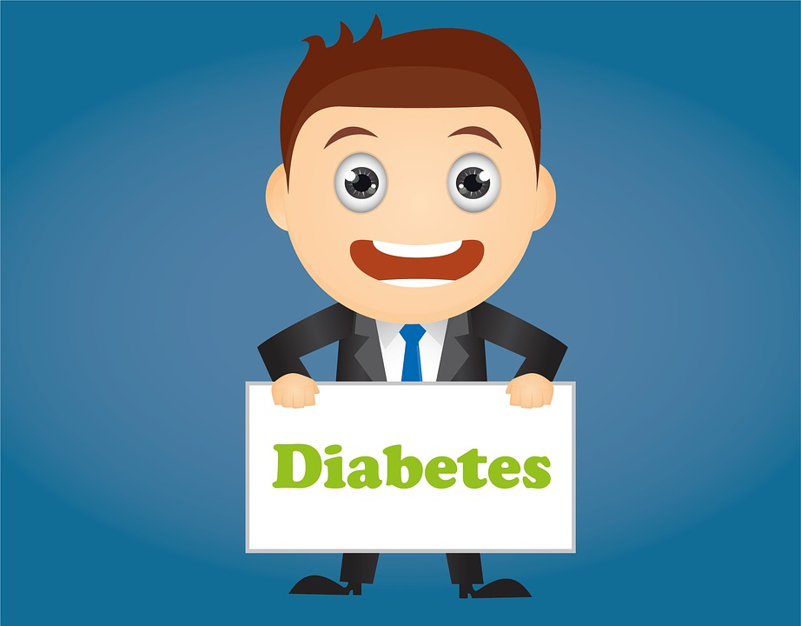
OBJECTIVE:-
To develop a user-friendly web application for early-stage diabetes prediction.
To predict whether a person is diabetic or not using basic medical details like glucose level, blood pressure, BMI, insulin level, and age.
To reduce the processing time and improve prediction accuracy using machine learning techniques.
To support early diagnosis so that users can take preventive action or consult a doctor in time.
To evaluate and compare the performance of different machine learning models.

Slide 6





SOFTWARE USED:-
Pycharm
Jupyter
DATA ANALYSIS AND PREDICTION:-
Numpy
Pandas
Scikit Learn
DATA VISUALIZATION:-
Matplotlib
Seaborn
FRONTEND AND BACKEND:-
HTML, CSS
Django

Slide 7
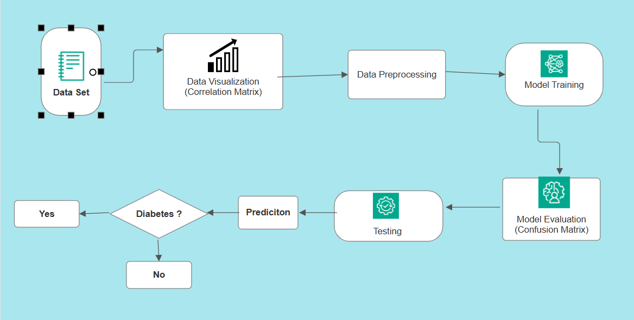
DATA FLOW DIAGRAM:-

Slide 8
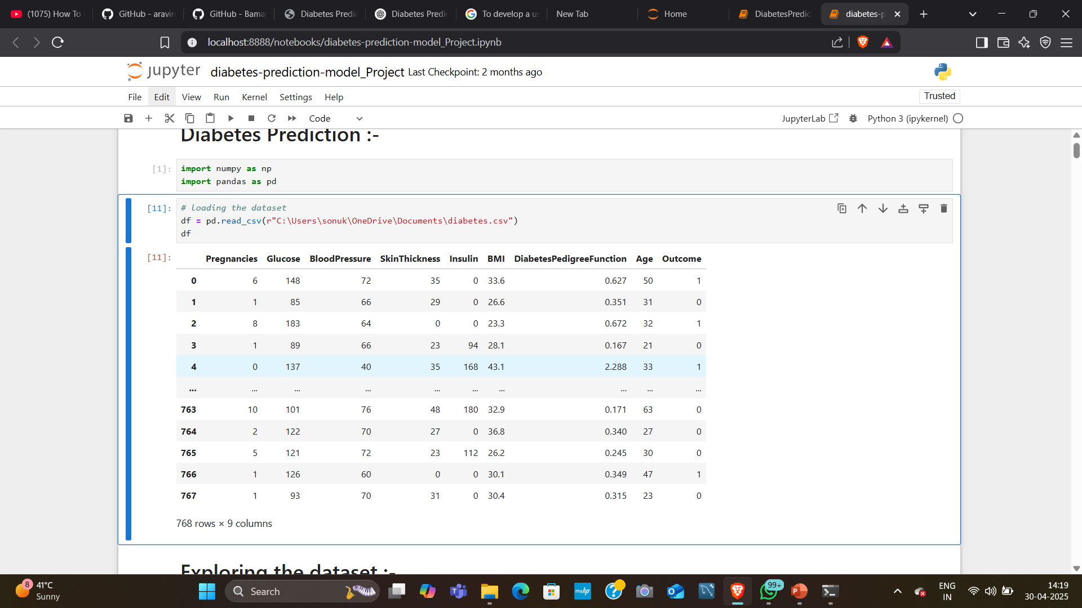
SAMPLE DATA:-
The dataset used in this paper was obtained from the Kaggle “Pima Indians Diabetes Database.
This dataset has 768 samples of diabetic and healthy individuals.

Slide 9
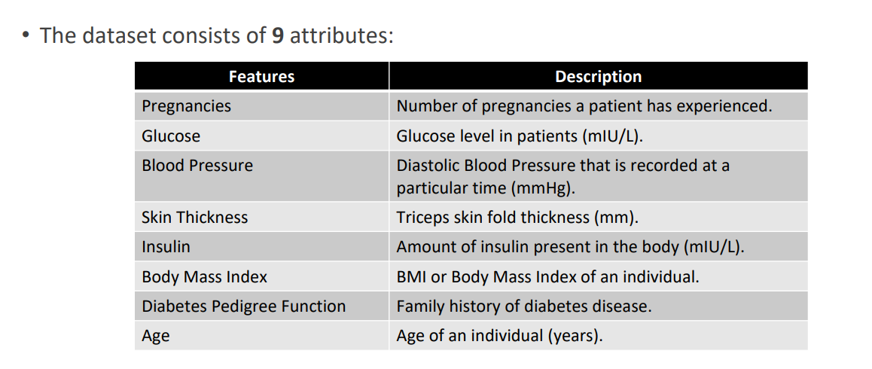
ATTRIBUTE IN THE DATASET:-

Slide 10
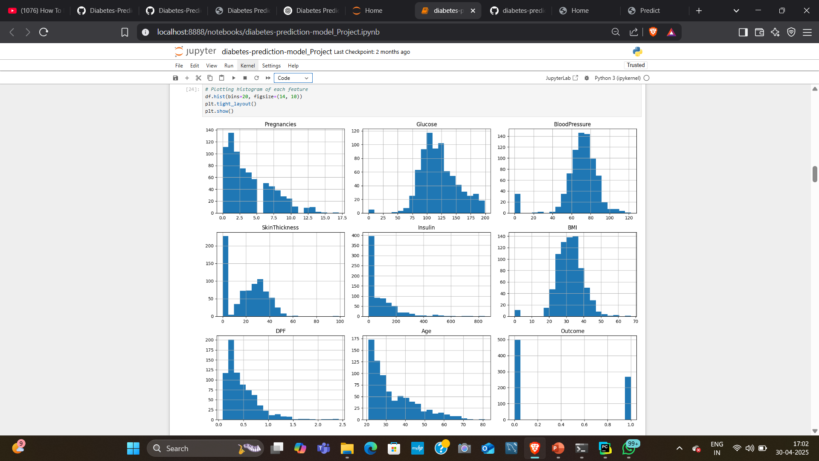
VISUALIZATION:-

Slide 11
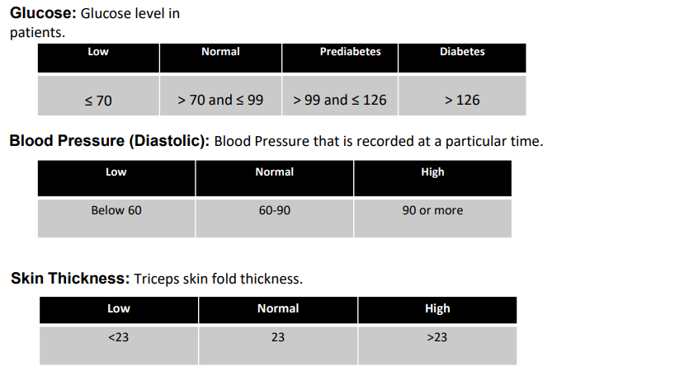
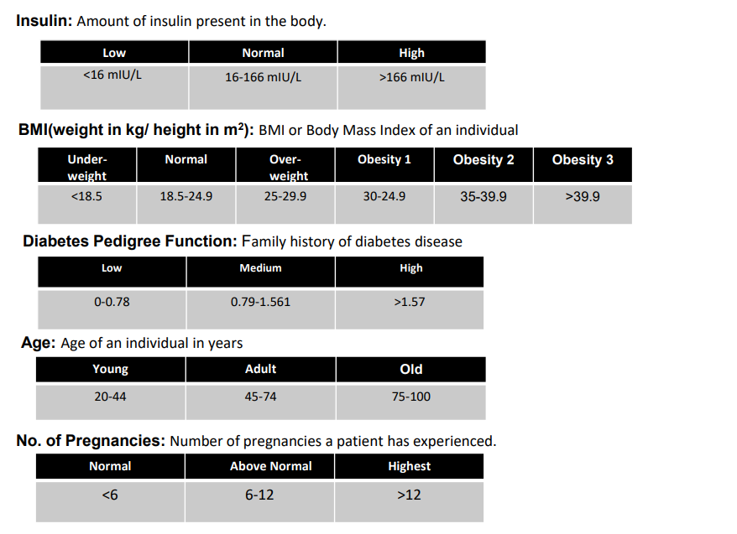
Categorizing Data:-

Slide 12
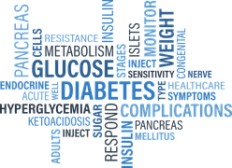
MODEL TRAINING:-
This phase include training different classifier for prediction.
Data was divided into 80% training and 20% testing data.
The machine learning algorithms used in this study are:
Decision Tree
Random Forest
Support Vector Machine

Slide 13
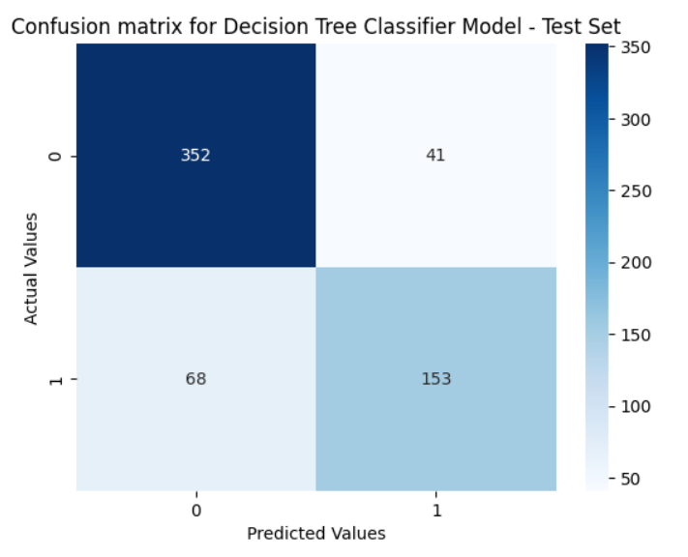
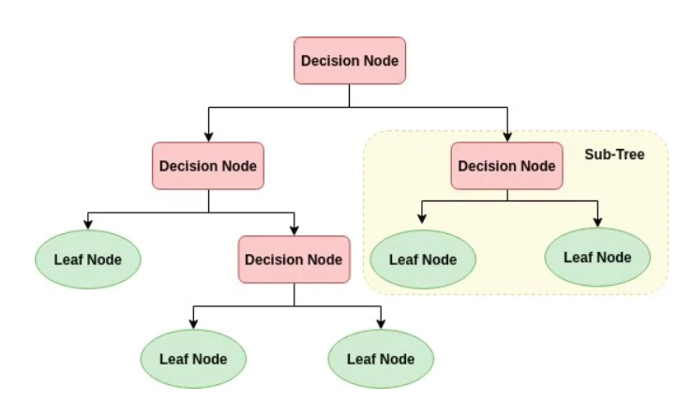
DECISION TREE CLASSIFIER:-
DECISION TREE MODEL
The Accuracy of Decision Tree is 75.32%

Slide 14
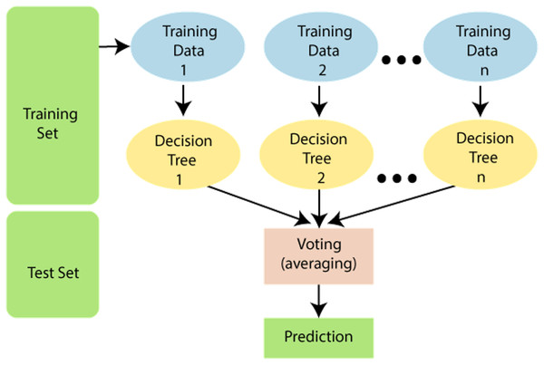

RANDOM FOREST CLASSIFIER:-
RF MODEL
The Accuracy of Random forest is 79.86%

Slide 15
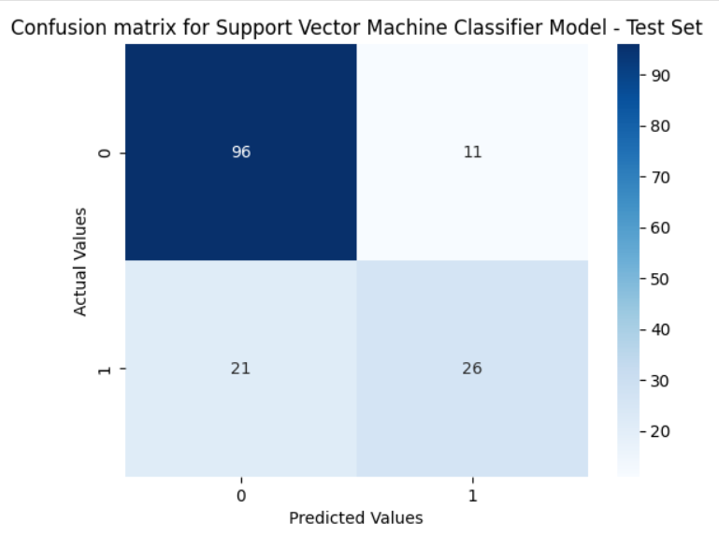
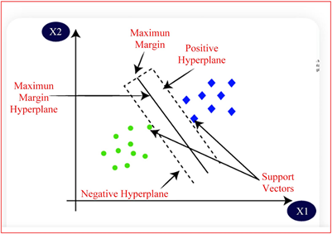
SUPPORT VECTOR MACHINE:-
SVM MODEL
The Accuracy of SVM is 76.22%

Slide 16
RESULTS AND DISCUSSION
The proposed approach uses different classification and ensemble methods and implemented using python.
These methods are standard Machine Learning methods used to obtain the best accuracy from data.
In this work we see that random forest classifier achieves better compared to others.
Overall, we have used best Machine Learning techniques for prediction and to achieve high performance accuracy.
Figure shows the result of these Machine Learning method
 | Accuracy
Decision Tree | 75.32
Random Forest | 79.86
Support Vector Machine | 76.22

Slide 17
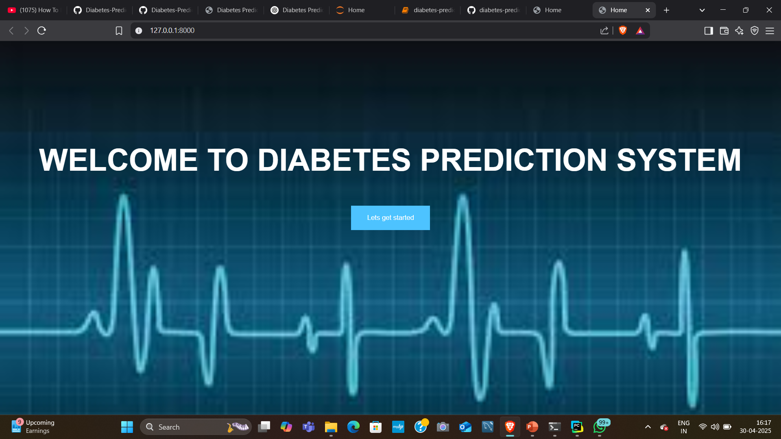
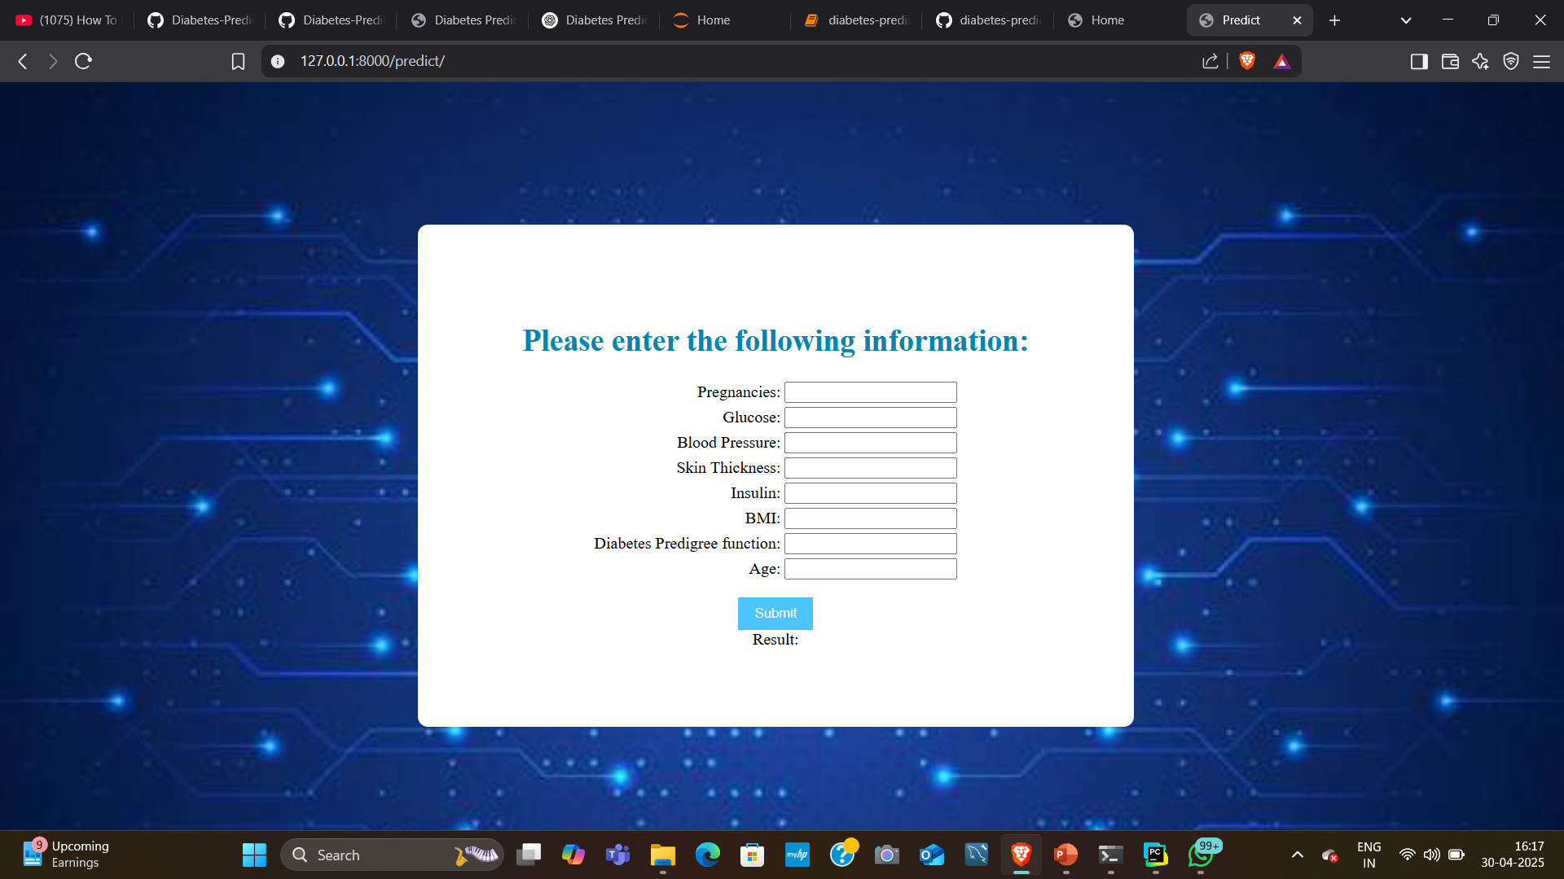
WEB PAGE:-
HOME PAGE
PREDICTION PAGE

Slide 18
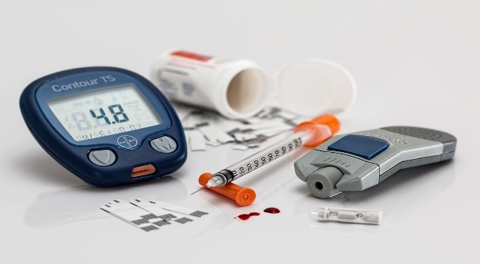
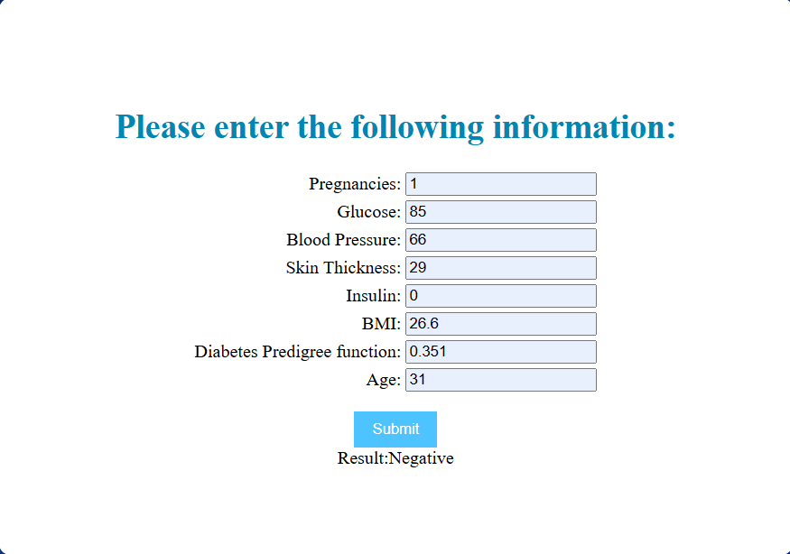
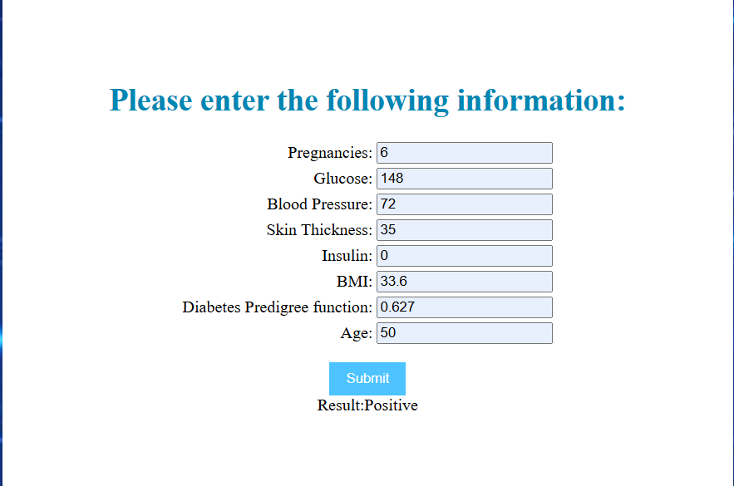
RESULT:-
Prediction 1
Prediction 2

Slide 19
FUTURE SCOPE:-
Integration of Real-Time Data:- Future versions can include data from wearable health devices to provide real-time predictions.
Mobile App Development:- Creating an Android/iOS app for easier access and portability.
Advanced Models:- Use deep learning or ensemble techniques to further improve accuracy.
User Accounts & History:- Implement login and personalized dashboards where users can track their prediction.
CONCLUSION:-
The Diabetes Prediction System is a web-based tool that uses ML to assess diabetes risk.
It analyzes basic health inputs such as glucose level, blood pressure, BMI, insulin level, and age.
The system helps with early diagnosis, especially for people without regular access to medical checkups.
It combines healthcare and technology, showing how ML can enhance medical support.
The platform is user-friendly, quick, and accurate, providing results instantly.

Slide 20
REFERENCES
UCI Machine Learning Repository - Pima Indians Diabetes Dataset
Scikit-learn documentation - https://scikit-learn.org
Django Documentation - https://docs.djangoproject.com
Bootstrap Official Site - https://getbootstrap.com
Streamlit Documentation (optional if used) - https://docs.streamlit.io
Research papers on Diabetes Prediction using Machine Learning (from Google Scholar / ResearchGate)

Slide 21


